Slide 1

Gene Expression Analysis in R
August 24, 2022
The R/Medicine conference
Higher Intelligence. Deeper Insight. Smarter Decisions.

Slide 2
Bulk RNA-Seq Analysis in R
Raw Reads (FASTA)
Quality Control (FASTQ)
Alignment (SAM, BAM)
Assign aligned reads to genes and create a count matrix
Differential Expression
Supercomputer, STAR
R/Rstudio
DESeq2

Slide 3



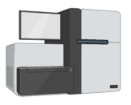
5 advanced-stage metastatic prostate cancer patients
For each patient:
Treat with DMSO for 24 hours (control)
Harvest cells, extract total RNA
Prostate tumor biopsy
Tumor cells grown in petri dish
Bulk RNA-seq
Harvest cells, extract total RNA
Treat with LSD1i (SP2509) for 24 hours
5 patient samples that are DMSO treated
5 matched patient samples that are LSD1i treated

Slide 4
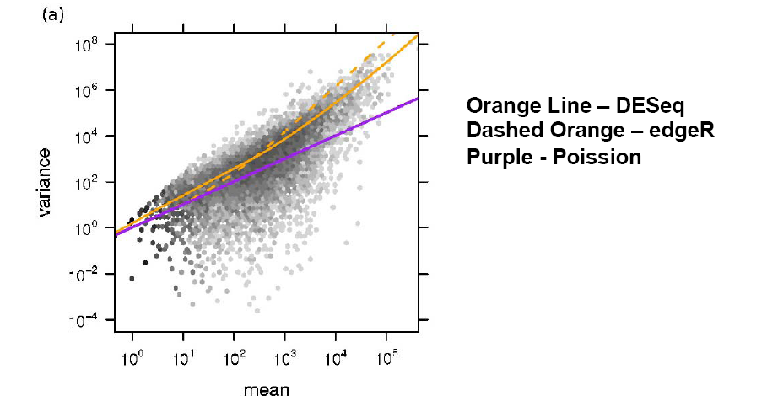
DESeq2

Slide 5
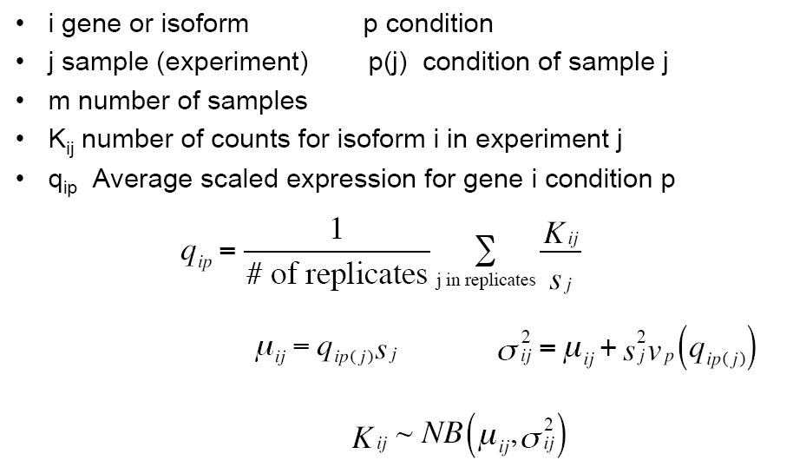


Slide 6
What DESeq2 Does?
Estimate size factor
Estimate Dispersions -> Maximum Likelihood Estimation (MLE)
Fit linear model
Hypothesis testing
Estimating dispersion from few numbers of replicates makes it unreliable
DESeq tries to solve this problem by sharing the information across the genes
DESeq assumes the genes with similar expression levels will also have similar dispersion values

Slide 7
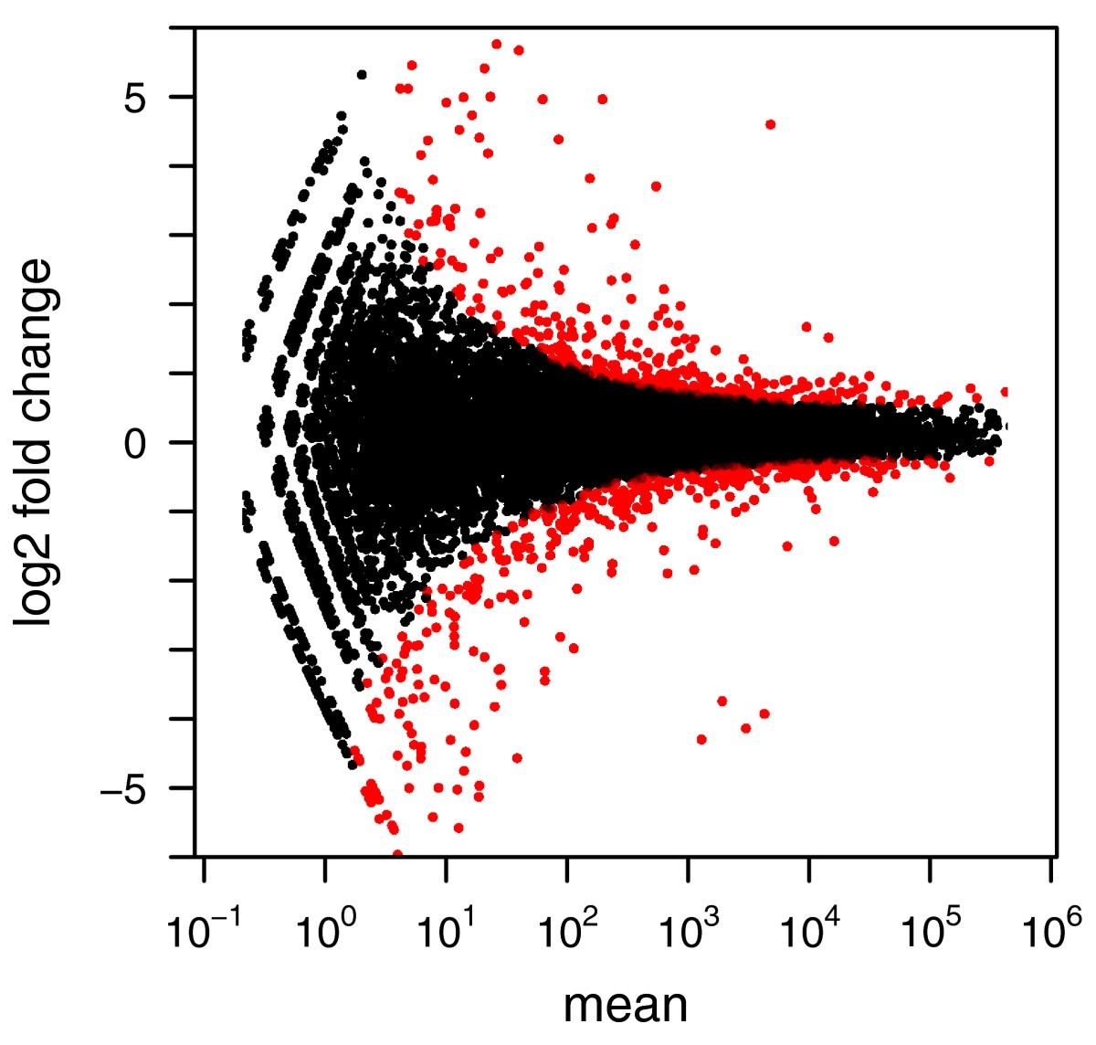
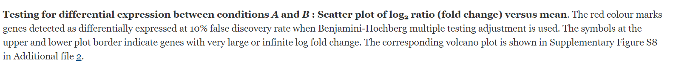
FDR=10%
Red: Significantly expressed
FDR=10%
Red: Significantly expressed

